Slide 1
How does the operating income of financial subsectors are trending from 2013 – 2015?
Here is the Bar chart for the Operating income trends in Financial subsectors for the years from 2013-2015..
From the chart, we can clearly conclude that they are not growing year by year..but the banking sector is making maximum income among all the companies.but for the year 2014 ,the income is lower than both from year 2013 and 2015.
Comparing to Banking sector,all the other subsectors are making negligible amount of opearing income..

Slide 2
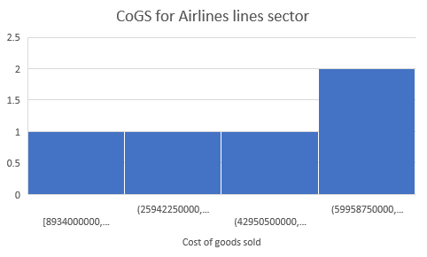
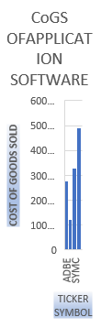
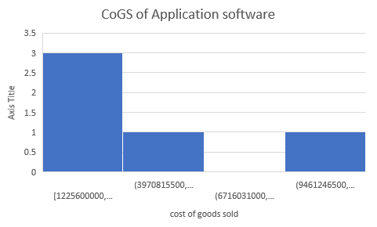
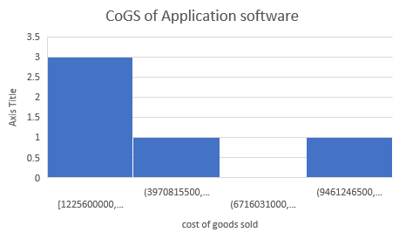
Is the CoGS expenditure higher in Airlines sector than in the Application software sector?
This is the histogram for the two subs sectors in financial sectors.. and how they are spending on CoGS expenses ..
The chart for the airlines CoGS is left skewed and the CoGS for Application software is right skewed..therefore the mean,which is 45,205,800,000 for Airlines CoGS is smaller than median 48,234,000000($48 billion)..and the standard dev is $27 billions.
And for the application software sector ,the expenses for the CoGS would be very less , in which the mean is $3 billion and the distribution is right skewed .so , the mean($3.05 billion) is greater then median ($3.04 billion) , standard dev is $1 billion ..
According to this, the Airlines sector is spending nearly 15- 16 times more for the CoGS expenses .. And the 50% of Airlines companies spending more than $48 billions on CoGS..because std deiation is more,the Airlines sector expenditure is more variant than application software sectors.

Slide 3

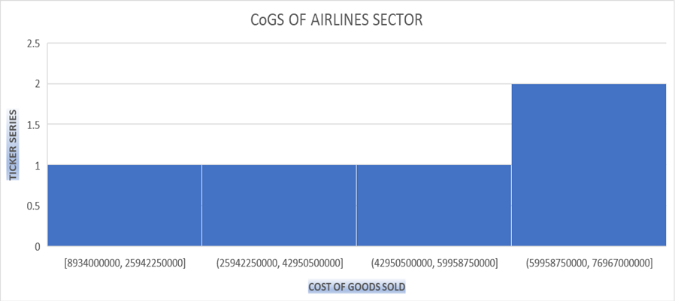
Is the CoGS expenditure higher in Airlines sector than in the Application software sector?
This is the histogram for the two subs sectors in financial sectors.. and how they are spending on CoGS expenses ..
The chart for the airlines CoGS is left skewed and the CoGS for Application software is right skewed..therefore the mean,which is $45billion for Airlines CoGS is smaller than median ($48 billion)..and the standard dev is $27 billions.
And for the application software sector ,the expenses for the CoGS would be very less , in which the mean is $3 billion and the distribution is right skewed .so , the mean($3.05 billion) is greater then median ($3.04 billion) , standard dev is $1 billion ..
According to this, the Airlines sector is spending nearly 15- 16 times more for the CoGS expenses .. And the 50% of Airlines companies spending more than $48 billions on CoGS..because std deiation is more,the Airlines sector expenditure is more variant than application software sectors.

Slide 4
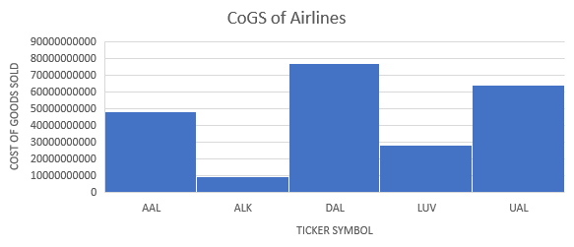
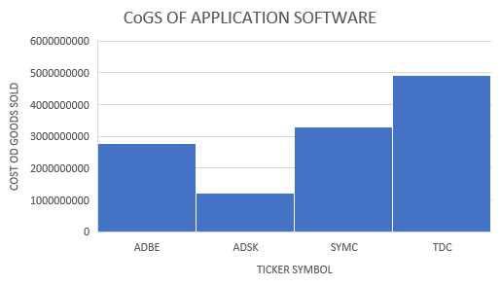
Is the CoGS expenditure higher in Airlines sector than in the Application software sector?
This is the histogram for the two subs sectors in financial sectors.. and how they are spending on CoGS expenses ..
The chart for the airlines CoGS is left skewed (mean is less than median)and the CoGS for Application software is right skewed(mean is greater than median).. the mean for CoGS is much more greater for Airlines CoGS than the mean for Application Software. is smaller than median ($48 billion)..and the median dor airlines is g15 times greater than Apllication software.. the Airlines sector is spending nearly 15- 16 times more for the CoGS expenses .. And the 50% of Airlines companies spending more than $48 billions on CoGS. standard dev for Airlines is $27 billions.it tells us that the expenditure onCoGS is more variant than in Application software.
And for the application software sector ,the expenses for the CoGS would be very less , in which the mean is $3 billion and the distribution is right skewed .so , the mean($3.05 billion) is greater then median ($3.04 billion) , standard dev is $1 billion ..
The range for Airlines CoGS is $36 billion,so we can say that the data set is widely spreadand expenses are more volatile in Airlines than in Application software.

